Slide 1

Conception et Paradigmes de Programmations par la Pratique
(C3P)
Advanced Object-Oriented Design
AVL an implementation of balanced trees
Artefact un générateur de documents PDF
Mohamed Mbengue Mseika Mariem
MM_MM

Slide 2
AVL
What is it? What does it do?
Artefact
Qu’est-ce que le projet? À ça sert?
Mutation
Conclusion
How?
Proposition
Testing

Slide 3
1

Slide 4
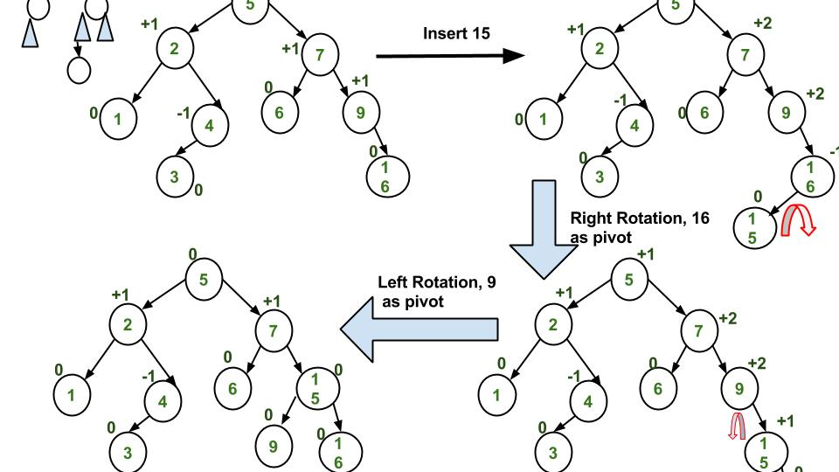
Presentation of AVL Tree
AVL Tree migration from Roassal 3
Mseika Mariem

Slide 5
What is AVL Tree migration from Roassal 3 and what is it used for?
AVL Tree is a data structure used in computer science to store elements in an organized way. It's a type of balanced binary search tree.
AVL Tree migration refers to the process of updating, transferring, or converting an implementation or usage of an AVL Tree data structure in a specific way from one version to another.

Slide 6
What is AVL Tree migration from Roassal 3 and what is it used for?
Roassal: Roassal is a data visualization library for the Smalltalk programming language. It's used to create interactive data visualizations, including charts, diagrams, maps, and more.
AVL trees are chosen for their balanced structure, predictable performance, and efficiency in various applications where fast and reliable search, insertion, and deletion operations are essential.

Slide 7
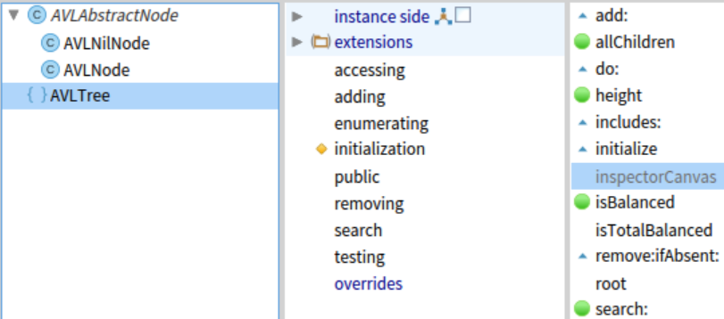
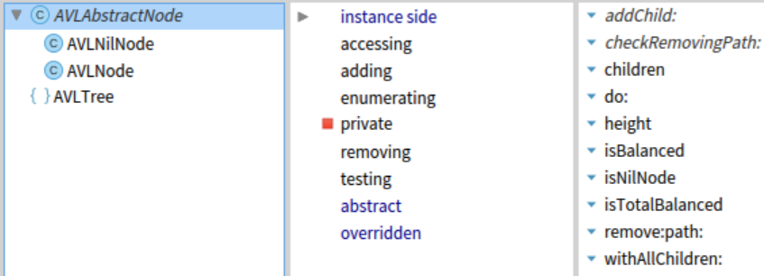
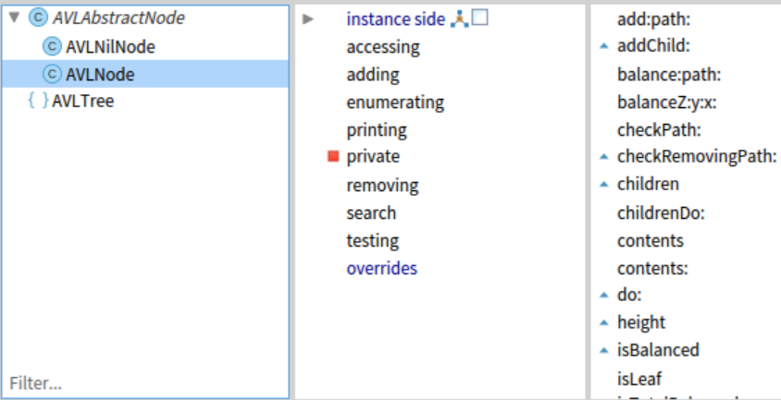
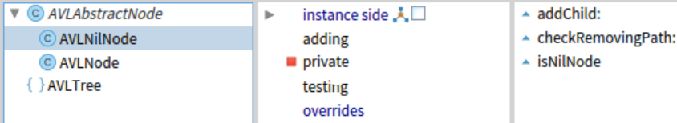
AVL Tree Package

Slide 8
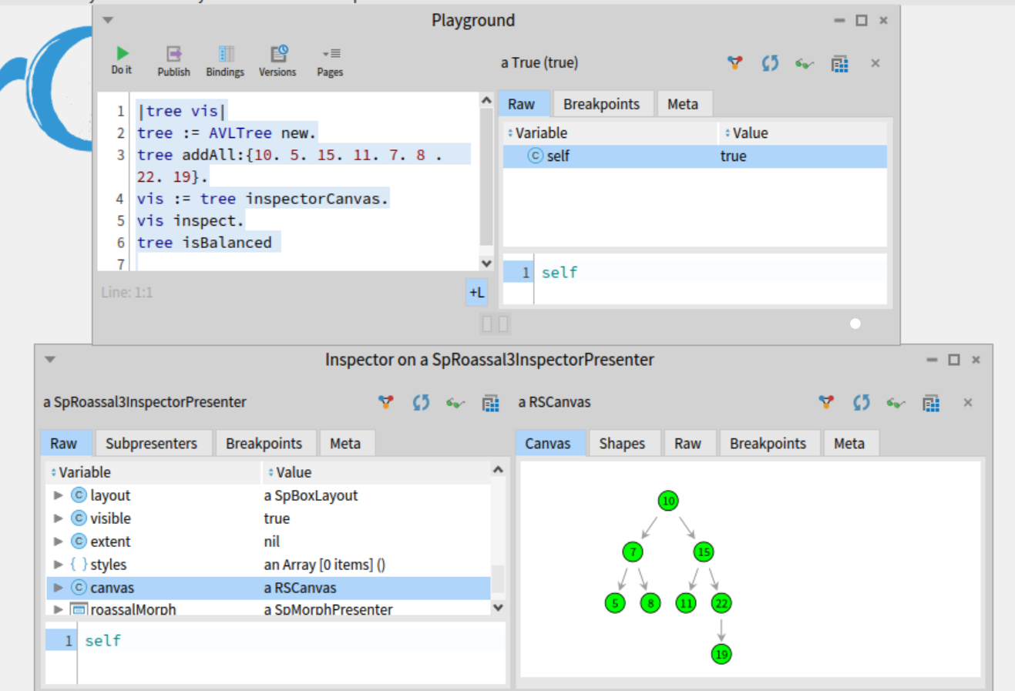
AVL Tree Inspector

Slide 9
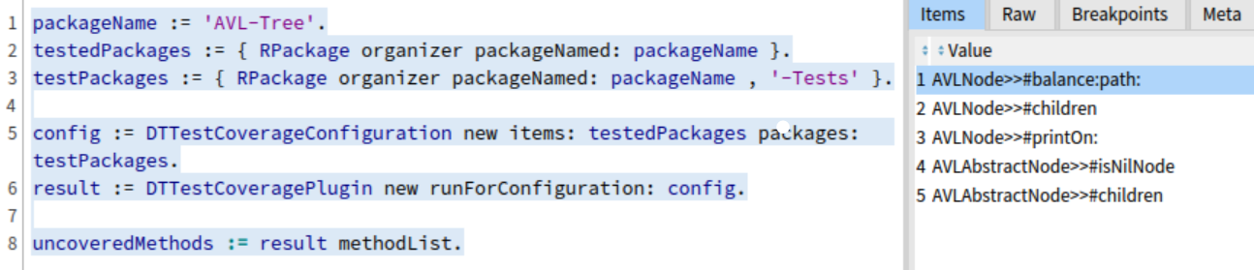
AVL Tree Tests

Slide 10
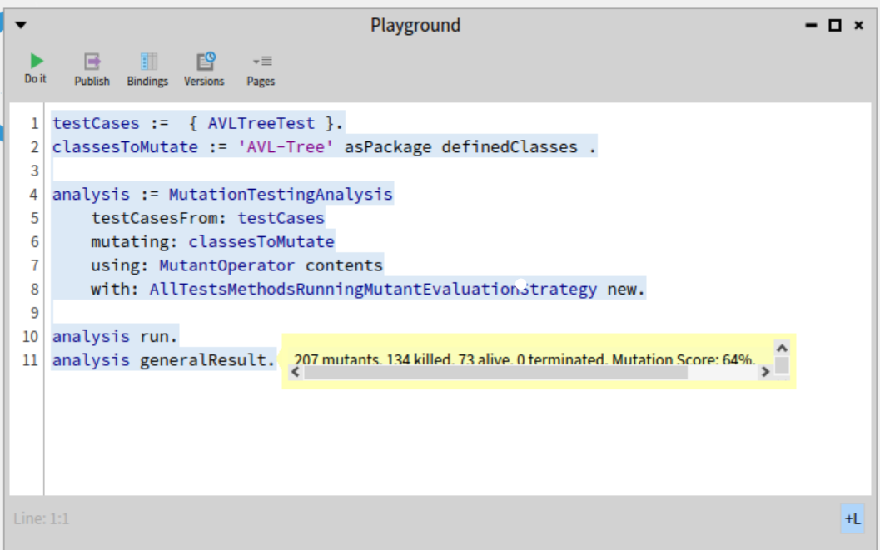
Mutation test/ General result

Slide 11
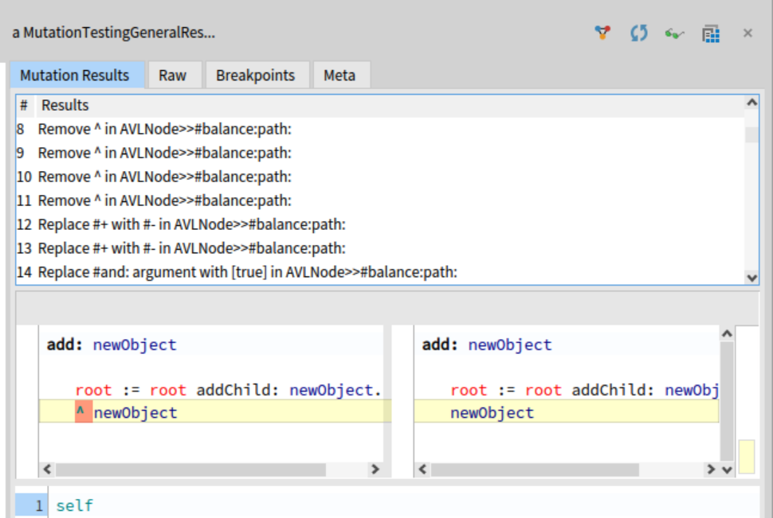
Mutation results /Changes made

Slide 12
What does AVL Tree lacks
fixed structure that does not adapt to the actual distribution of data.
The project lacks clear instructions for users.
There are tests in the project. However, they appear to be incomplete.
Complex(balancing rules and algorithms).

Slide 13
What improvements can be made?
Provide clear and comprehensive documentation for users.
finding ways to reduce this memory overhead.
Test suite is not strong enough and should be enhanced.

Slide 14
2

Slide 15
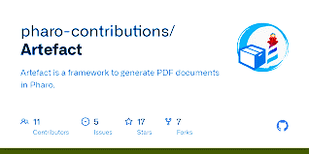
Présentation
D’Artefact
Artefact un générateur de documents PDF
Mohamed Mbengue

Slide 16


Projet Artefact
C’est quoi Artefact ?
Smalltalk
Est-elle réellement utile ou Bloatware
Quel est le rapport avec Artefact
Mais est-ce que « Artefact » est inutile

Slide 17


Utilisation d’artefact
01

Slide 18
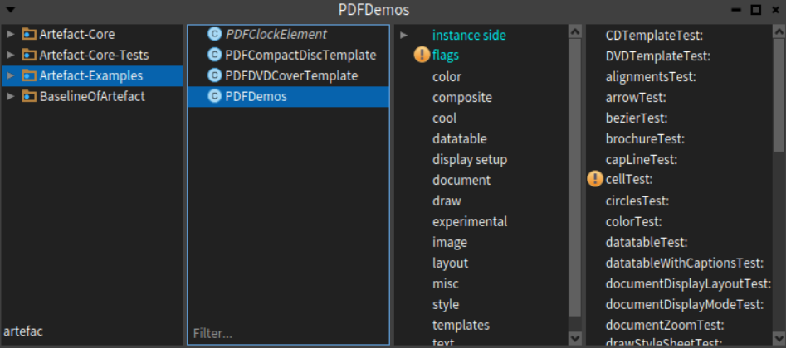

Slide 19
Nous allons exécuter les méthodes :
brochureTest
datatableTest
imageJPGTest
mosaiqueTest

Slide 20
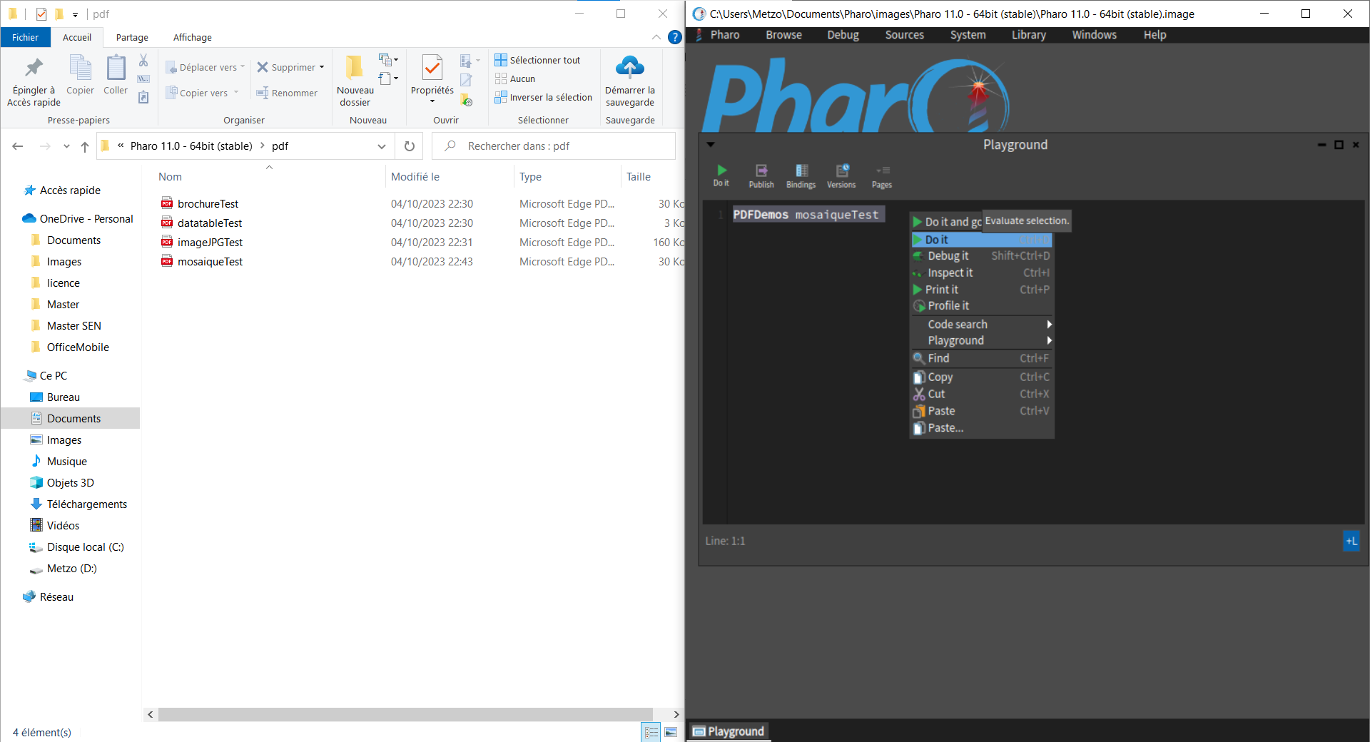

Slide 21
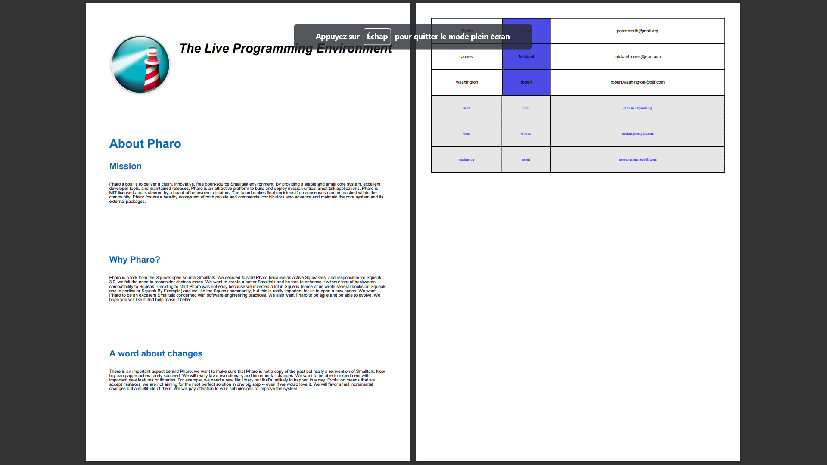

Slide 22


Slide 23
Les Tests
02

Slide 24
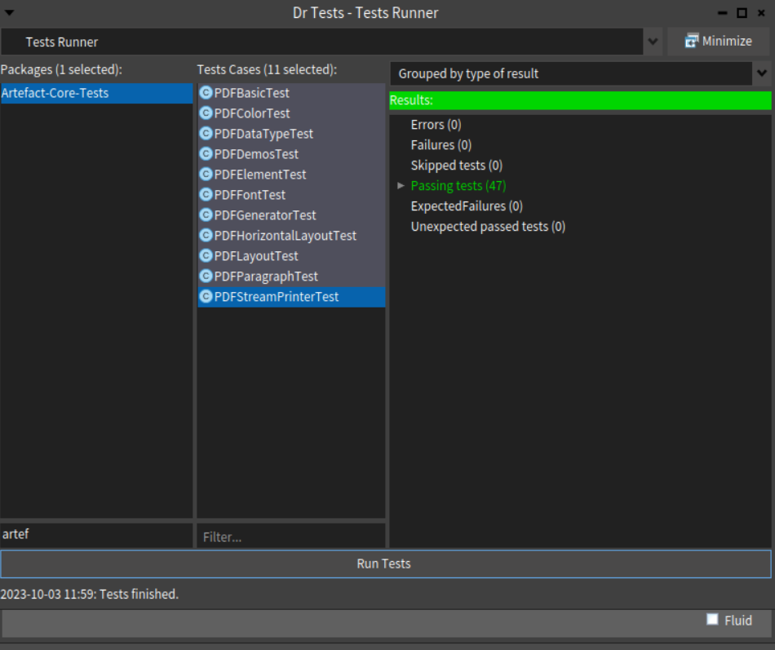

Slide 25
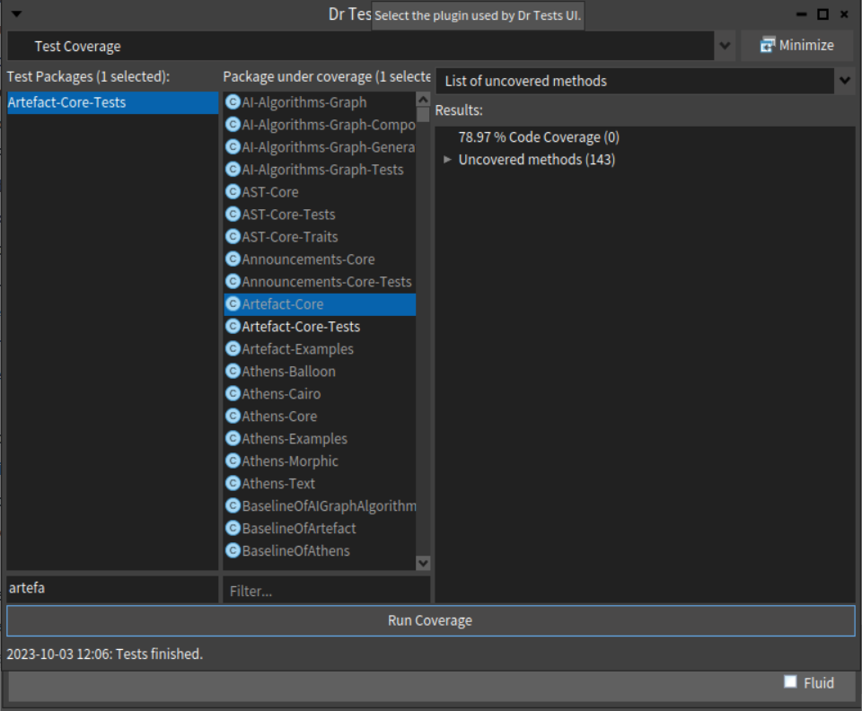

Slide 26
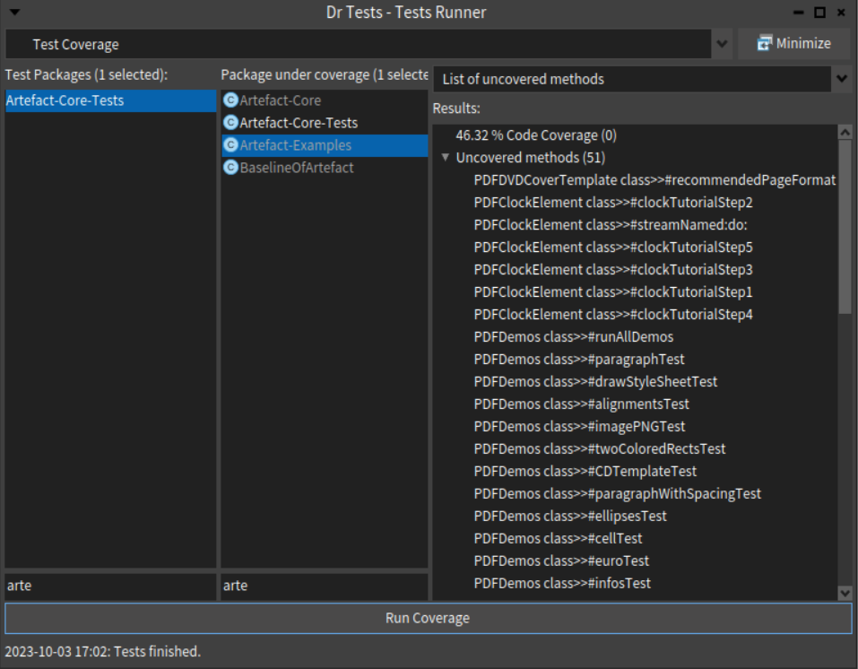

Slide 27
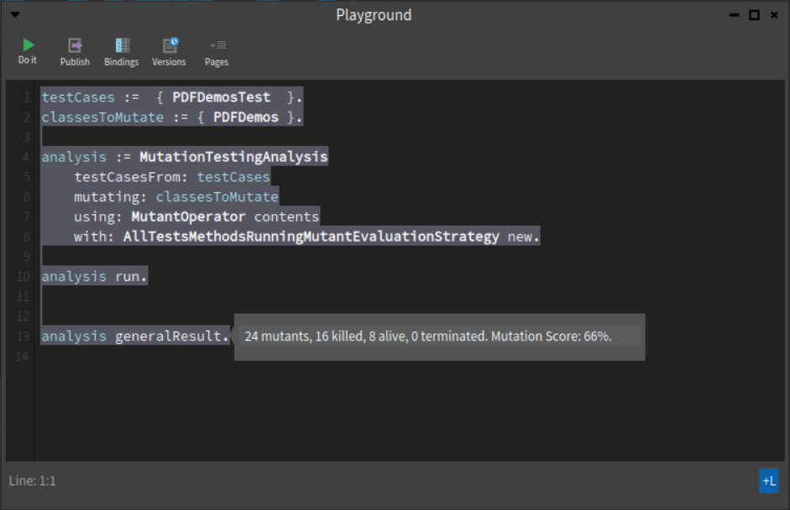

Slide 28
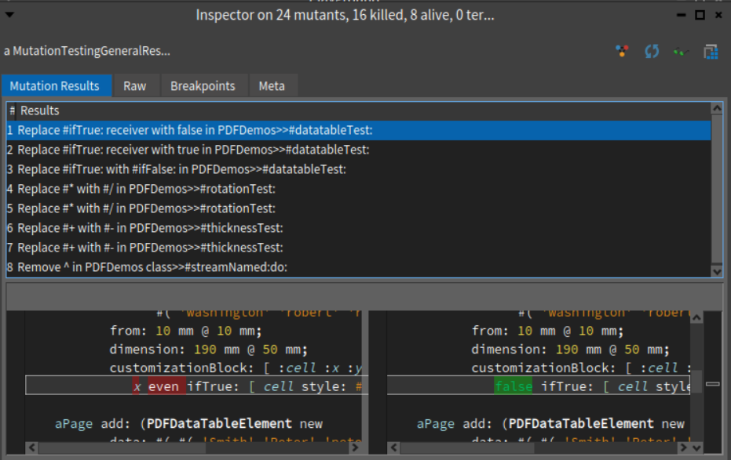

Slide 29
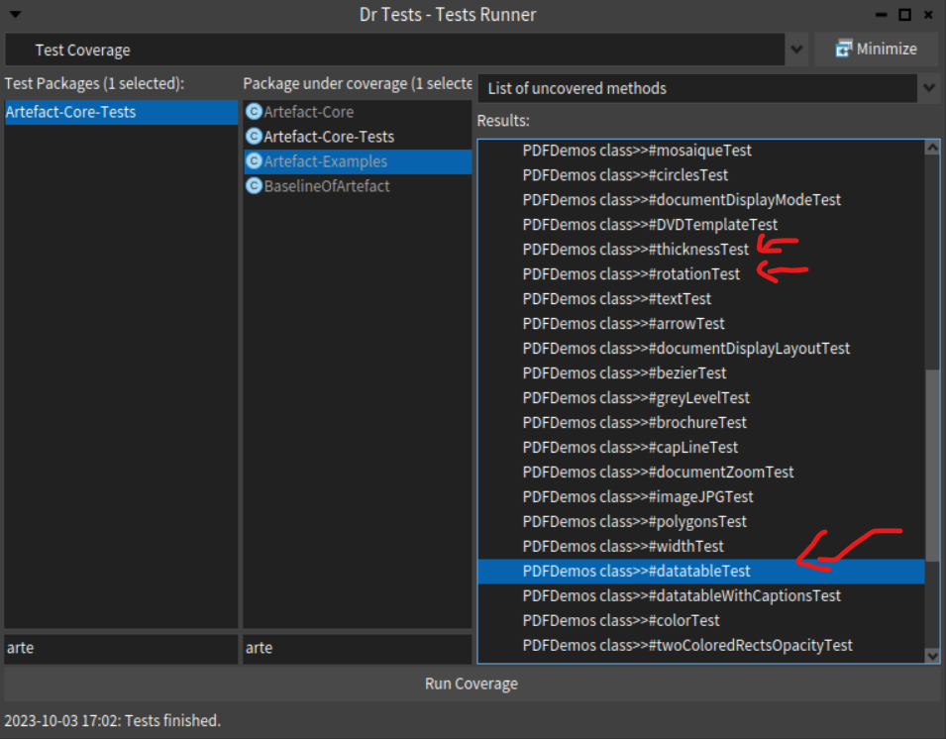

Slide 30
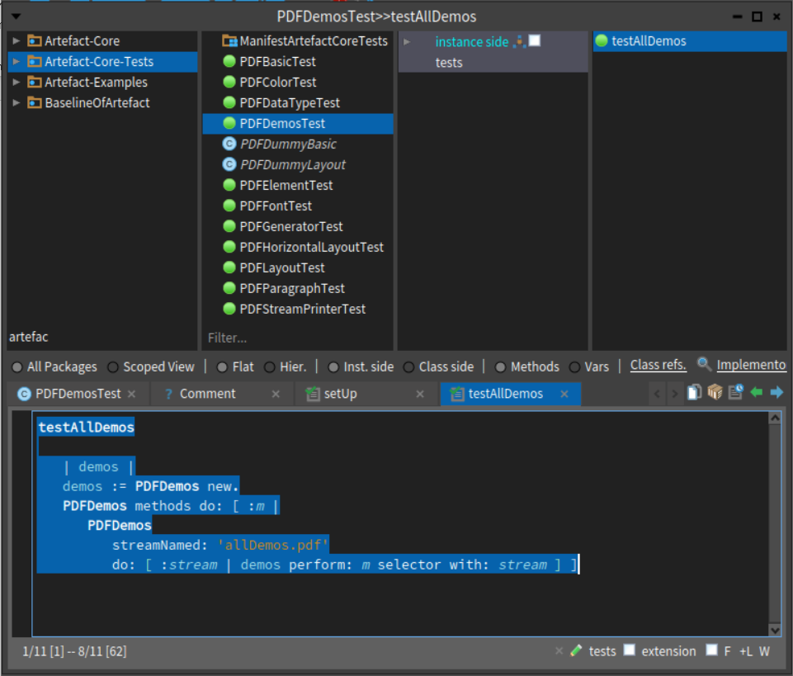

Slide 31
Ce que j’ai appris
03

Slide 32
Les tests peuvent fonctionner sur des méthodes non couvert
Comment est ce possible ?
Un bon score de couverture renseigne t’il sur la qualité d’un test
Suggestion pour améliorer le test PDFDemosTest

